Slide 1
IoT Data Alchemist Hackaton
미세먼지를 피할수 있는 산책로 찾기 시스템
Find trails system for avoid fine dust
TEAM NUGABAR
Notes:
Hi my name is Sung-ho Yun
I’m charge of the presentaion by the team
From now on, i'll start presentation about our topic
Our topic is find trails system for avoid fine dust

Slide 2
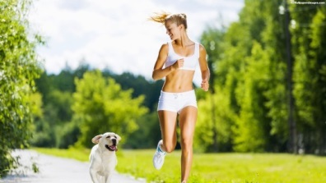
2017 창의적 종합설계 경진대회
Develop Motive
Walking Effect
Obesity, diabetes, depression, cancer risk falls
Creativity is enhanced by walking
Proper sunshine, better than a pill.
Dementia can be prevented.
Notes:
First I will explain the development motive.
Walking has a enormous positive effect on our bodies.
First It reduces the risk of obesity, diabetes, depression, cancer.
According to the researchers, maintaining a habit of walking for 30 minutes in every day that will significantly reduce the risk of obesity, diabetes and depression.
Second is more Creative
according the research of Stanford University
People are more creative when walking than sitting
Third strengthens the body's immune function and helps the wound heal quickly.
Fourth Walking provides energy to the brain, that helps prevent brain degeneration
So can be prevented dementia

Slide 3
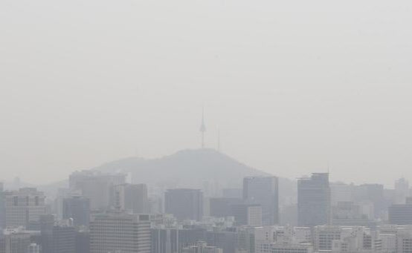
2017 창의적 종합설계 경진대회
개발 동기
direct cause of various respiratory diseases
Causes of atopic dermatitis
Increased risk of underweight and
stillbirth in newborns
Causes headaches.
World's second worst air quality
< Seoul fine dust situation >
Notes:
But we can’t go out for walking because korea’s air status is bad
According to the Air Visual, that is the world's air pollution status monitoring Organization,
That Organization’s announcement is Seoul's Air Quality Index (AQI) was 179 that is world’s second worst air quality

Slide 4
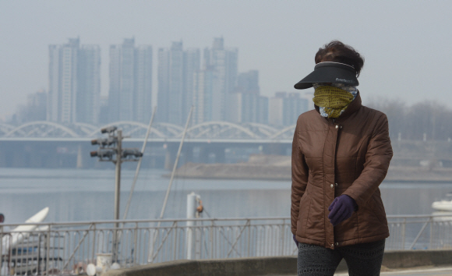
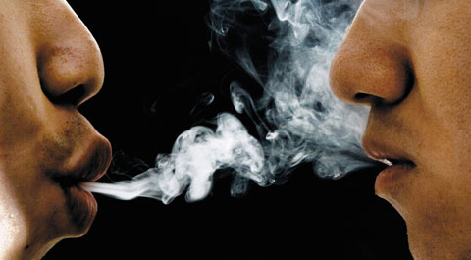


2017 창의적 종합설계 경진대회
개발 동기
< 60 minutes walking in fine dust >
< Secondhand smoke 84 minutes>
Notes:
If you walking in fine dust environment at 60 minutes that is negative effect equals secondhand smoke at 84 minutes

Slide 5
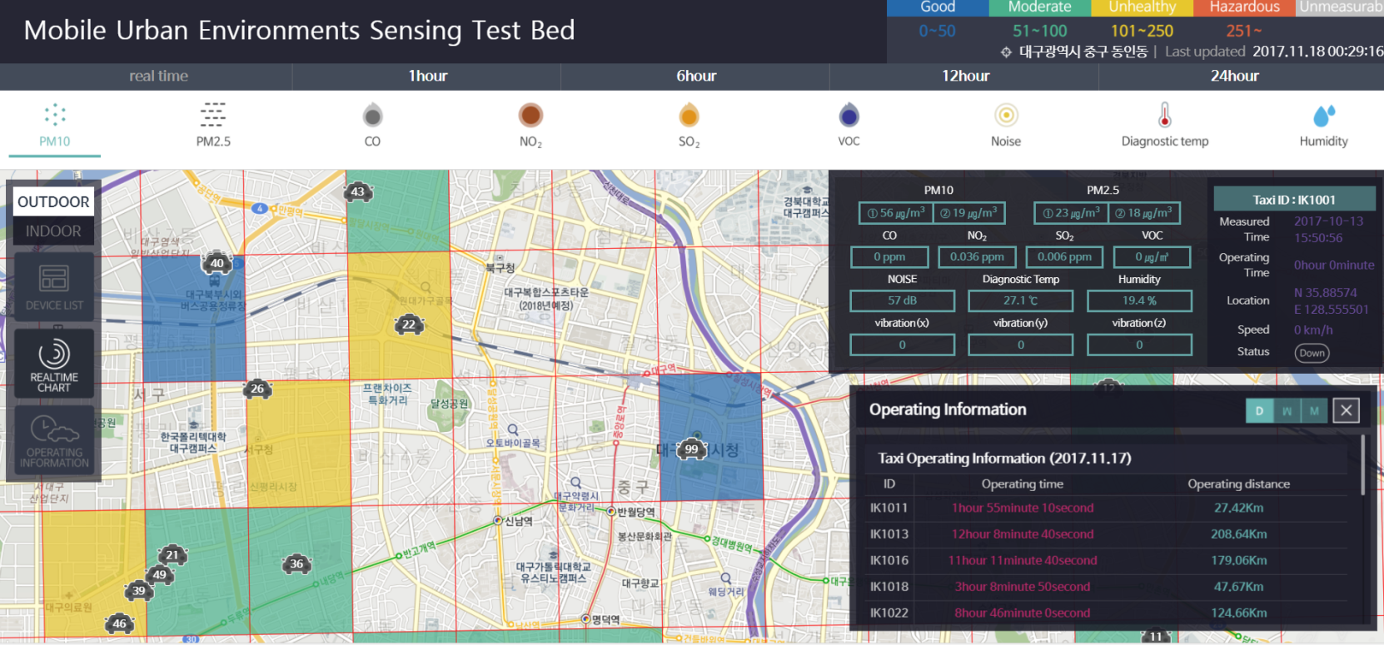
2017 창의적 종합설계 경진대회
개발 방법
<Mobile Urban Sensing Dataset>
Notes:
So we’ll ues Mobile Urban Sensing Dataset in Daegu
And use Mapping Algorithm system
We will provide the best trails.

Slide 6
THANK YOU
END

